Slide 1
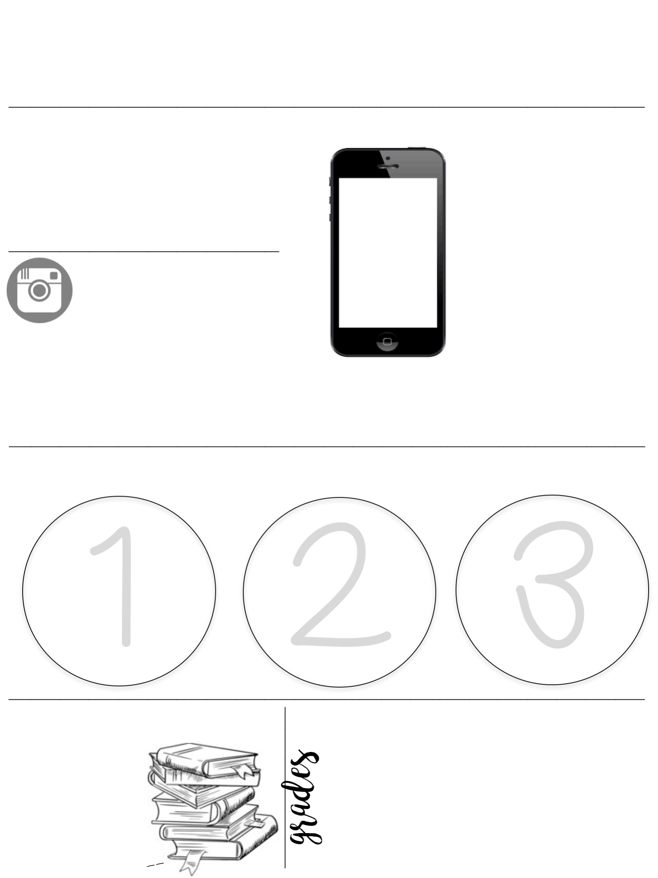
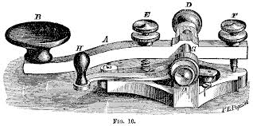
Government/Local History
Mr. Bauman
2018 -----
----- 2019
Communication
1 Rm. 147
2 mbauman@mckasd.net
3 (412) 664- 3650 ex. 147
AP Biology
Website
www.mrbaumanhistory.weebly.com
All class materials, announcements, and assignments will be published on the class website. You can also use it to submit your makeup work & ask me questions.
Resources
Responsibility and Preparation
_____________________________________________________________________________
Enter the room
on time and
prepared to start immediately .
Preform at a High Level of Academic Rigor
Maintain an Environment of Mutual Respect
_______________________________________________________________________________________
Class Materials
30%
20%
20%
20%
10%
Notebooks are needed and
Will be checked
____
Pencils & pens
________
Tests & Quizzes
Class &
Homework
Projects &
Unit Tests
Daily Assignments
Daily Assignments
& Homework
________
Participation
Appropriate Dress

Slide 2
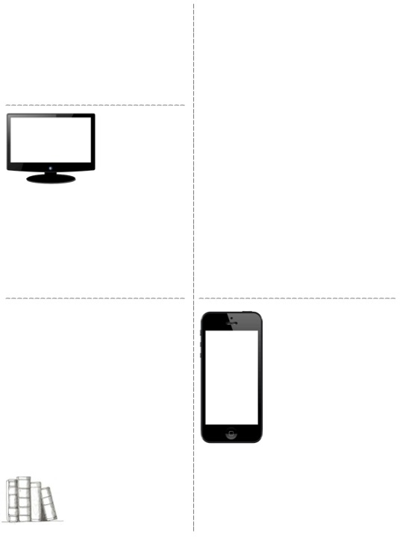
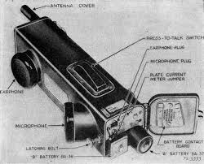
Food and drink policy
Class Absences
In general, food and drinks are allowed in my class. This is contingent on it not becoming a distraction in class, and as long as students can handle the responsibility. This policy is subject to change at my discretion, and at any time.
Students are responsible for obtaining their missed work outside of their class period.
Work should be complete promptly, the next day for assignments, 1 week for projects & tests. Some projects cannot be made up.
Behavior related absences will be given work at the teacher’s discretion.
Assignment Formatting
Class Dismissal
Class dismissals (BR, locker, & other classes) should be rare and brief.
You may be asked to wait till an appropriate time.
Overuse will cause a loss of points
Full names must be written on all submitted work.
Complete sentences should be used.
Students should maintain a high level of effort/ accuracy.
Assignment specific instructions must be followed
Homework
Electronic Devices
Preparation is a must in this class. I suggest pre-writing your notes & reading before class.
Studying will be necessary to achieve a high grade.
Class time must be used for homework to be accepted
Failure to complete some work may disqualify from future projects
Devices should not be out during class,
Emergencies arise – notify me.
I will warn/ take at my discretion.
Behavior
Should not be an issue at this level.
Warning = Lost Points
Serious Offences = Removal & Lost Assignments

